Slide 1
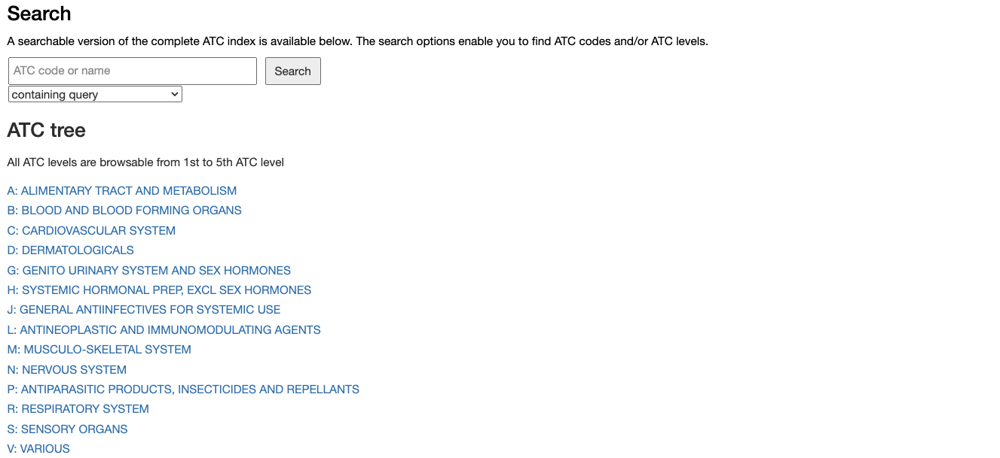
Type an ATC code here and press “Search”
or Click on an Anatomical group

Slide 2
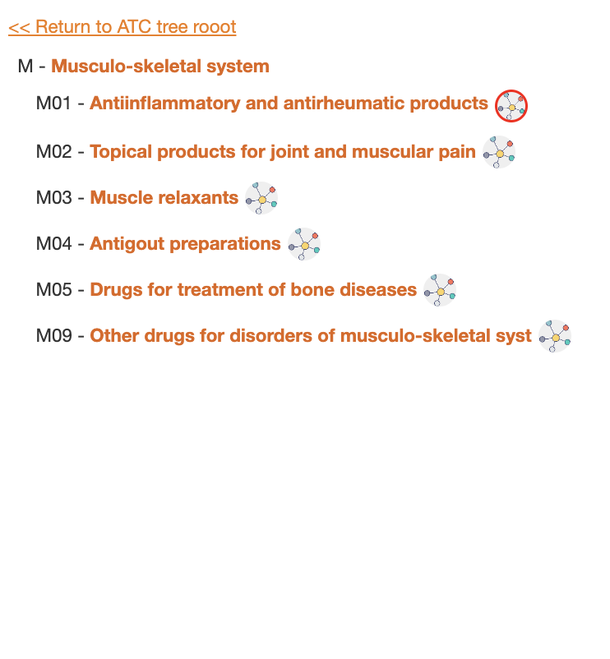
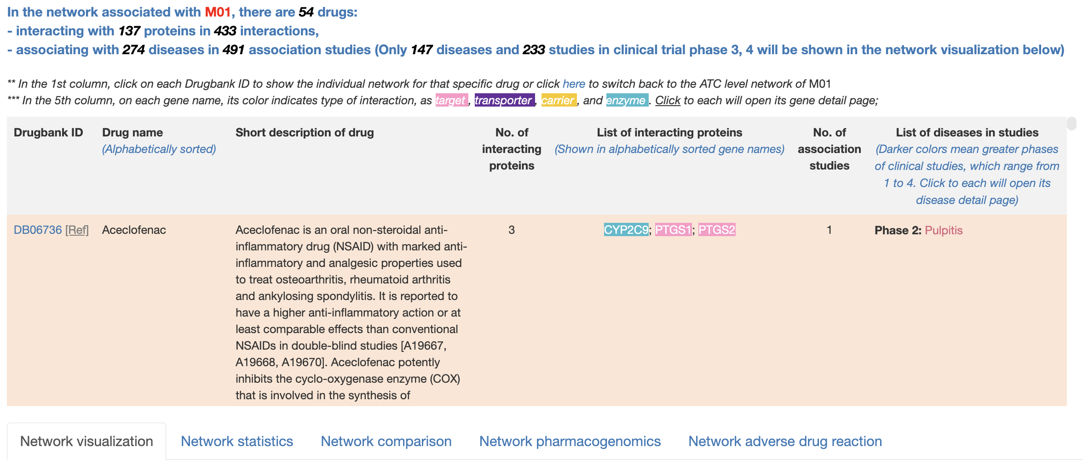
Click on the button to see the detailed drugs, indications, proteins in the network associated with M01 code
Overview table that lists drugs linked to the M01 and its related subcodes
Beneath the table is 5 tabs show different aspect of M01 network with network visualization set as default

Slide 3
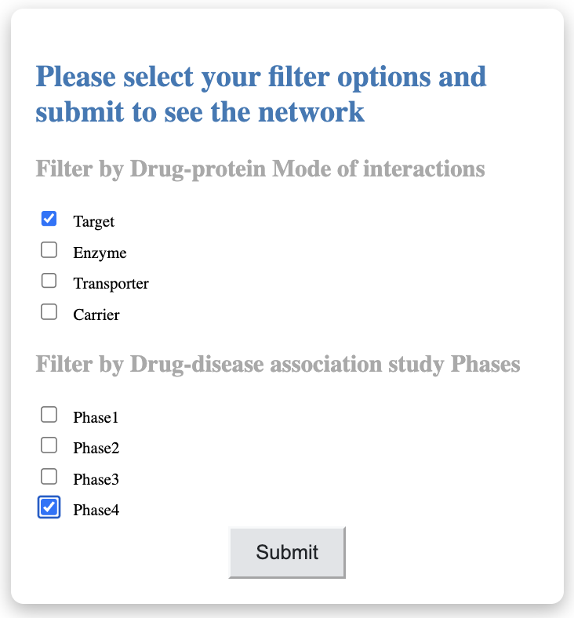
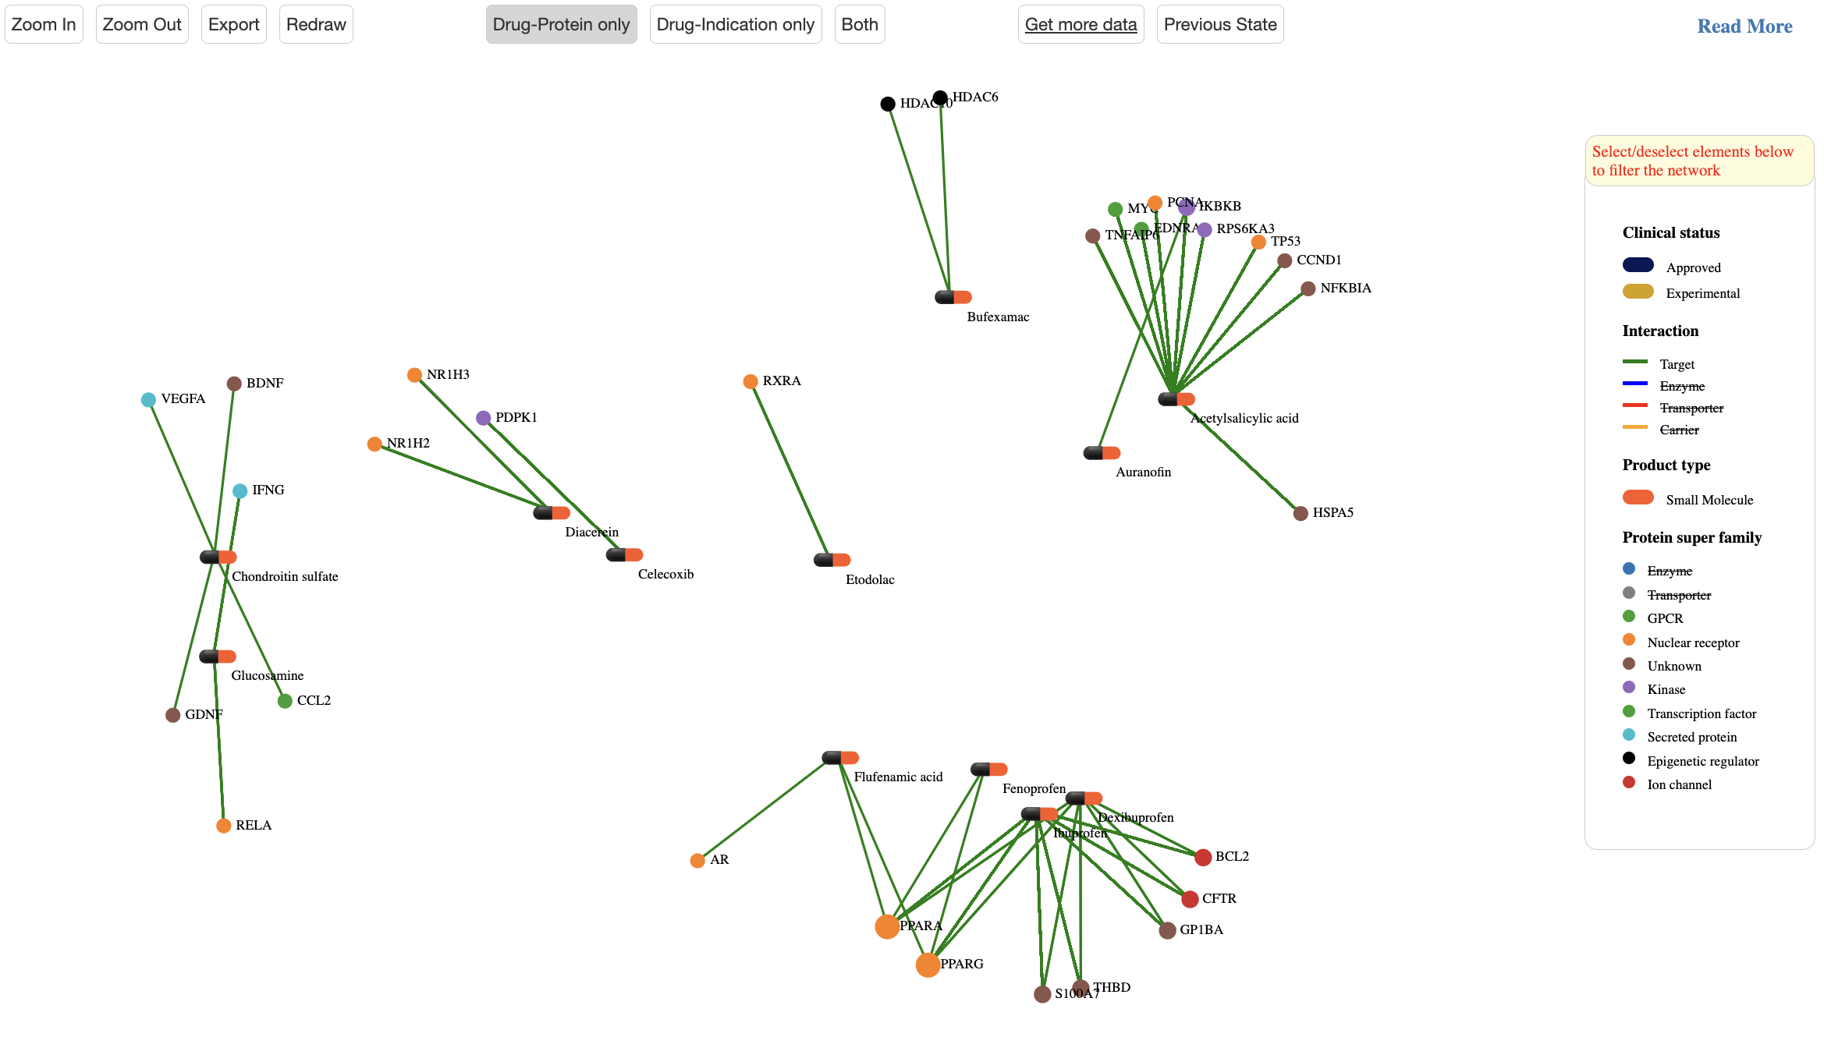
Use control buttons to zoom in/out, redraw or export it to image or csv format file
See parts of the network
Choose filters
Change filters

Slide 4
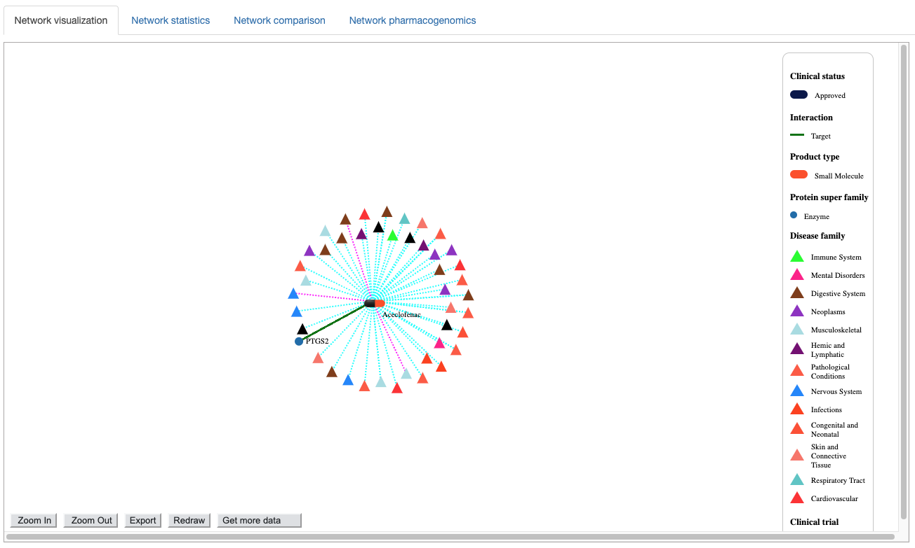
Click or unclick on an legend items to apply or remove filters
Use control buttons to zoom in/out, redraw, see hidden parts of the network or export it to image or csv format file

Slide 5
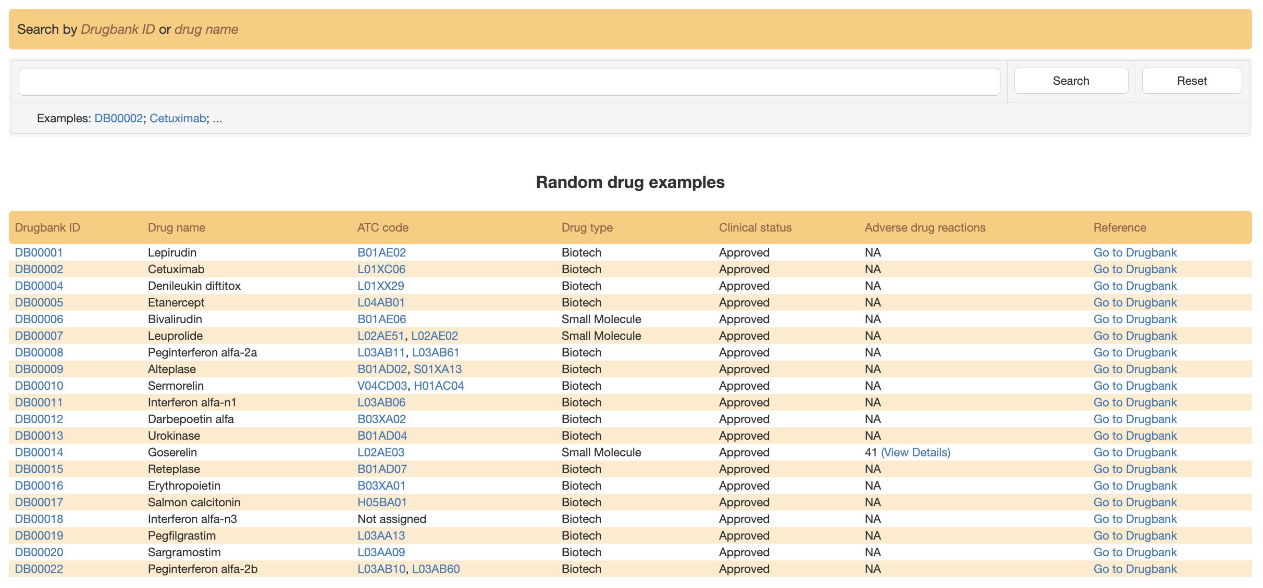
Use this search box to find a drug from its Drugbank ID or name. Autocomplete feature suggests possible matches as the user types.
Click here to see drug information in Drugbank
A drug can have no (not assigned), one or more than one assigned ATC code. Click here to open the ATC code network for more detailed information
Click here to see drug adverse reaction

Slide 6
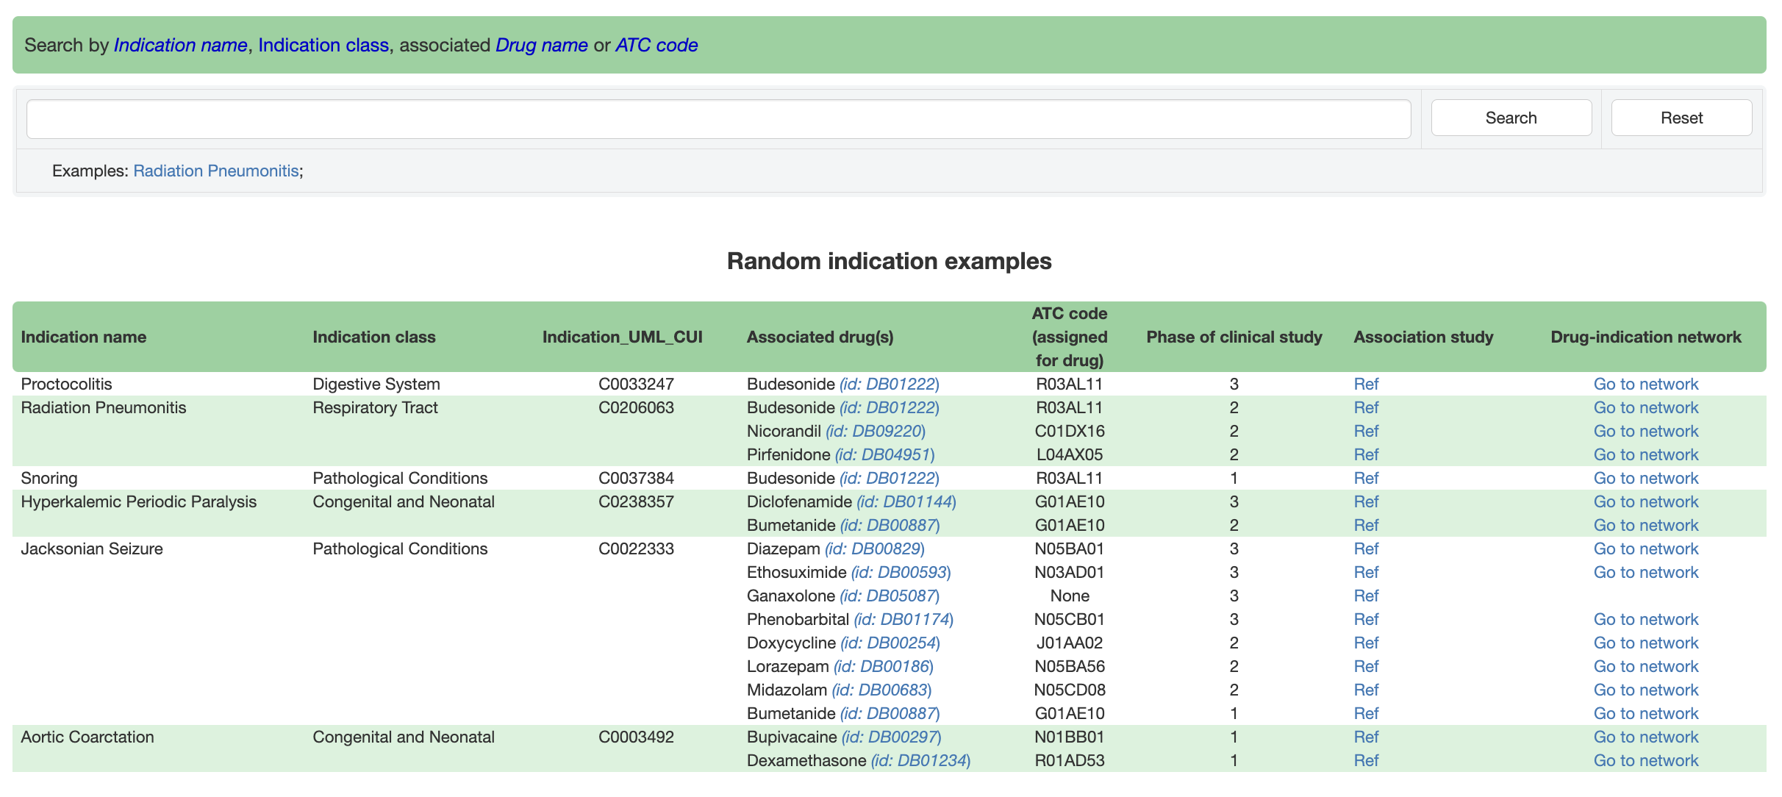
Use this search box to find a disease via its name. Autocomplete feature suggests possible matches as the user types.
Click here to see disease information in clinicaltrials.gov
Click here to open the drug-disease association network for more details

Slide 7
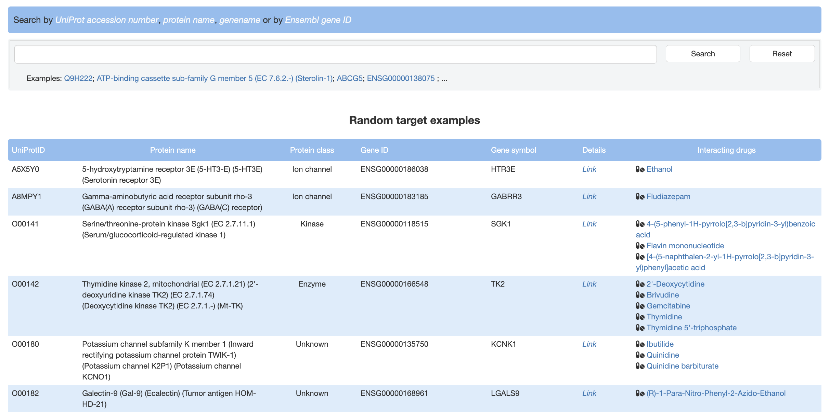
Use this search box to find a protein/gene. Autocomplete feature suggests possible matches as the user types.
Click here to open a detailed page for a protein/gene
Click on any drug to open the drug-protein interaction network for more details

Slide 8
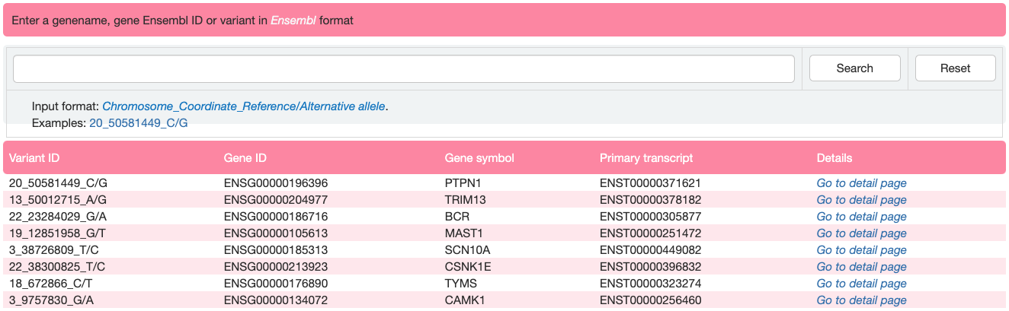
Use this search box to find a single variant. Autocomplete feature suggests possible matches as the user types.
Click here to open a detailed page for a protein/gene where the variant occurs

Slide 9
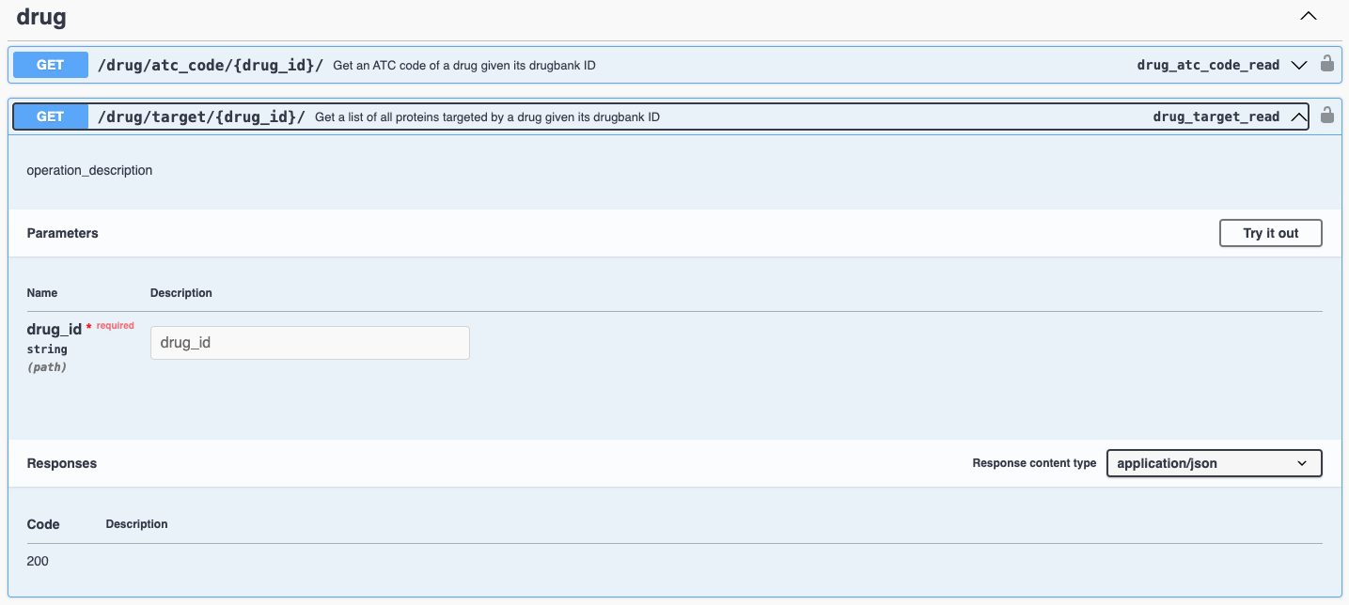
Click here to retrieve data for a single entry
Input entry id here and press “Execute”

Slide 10
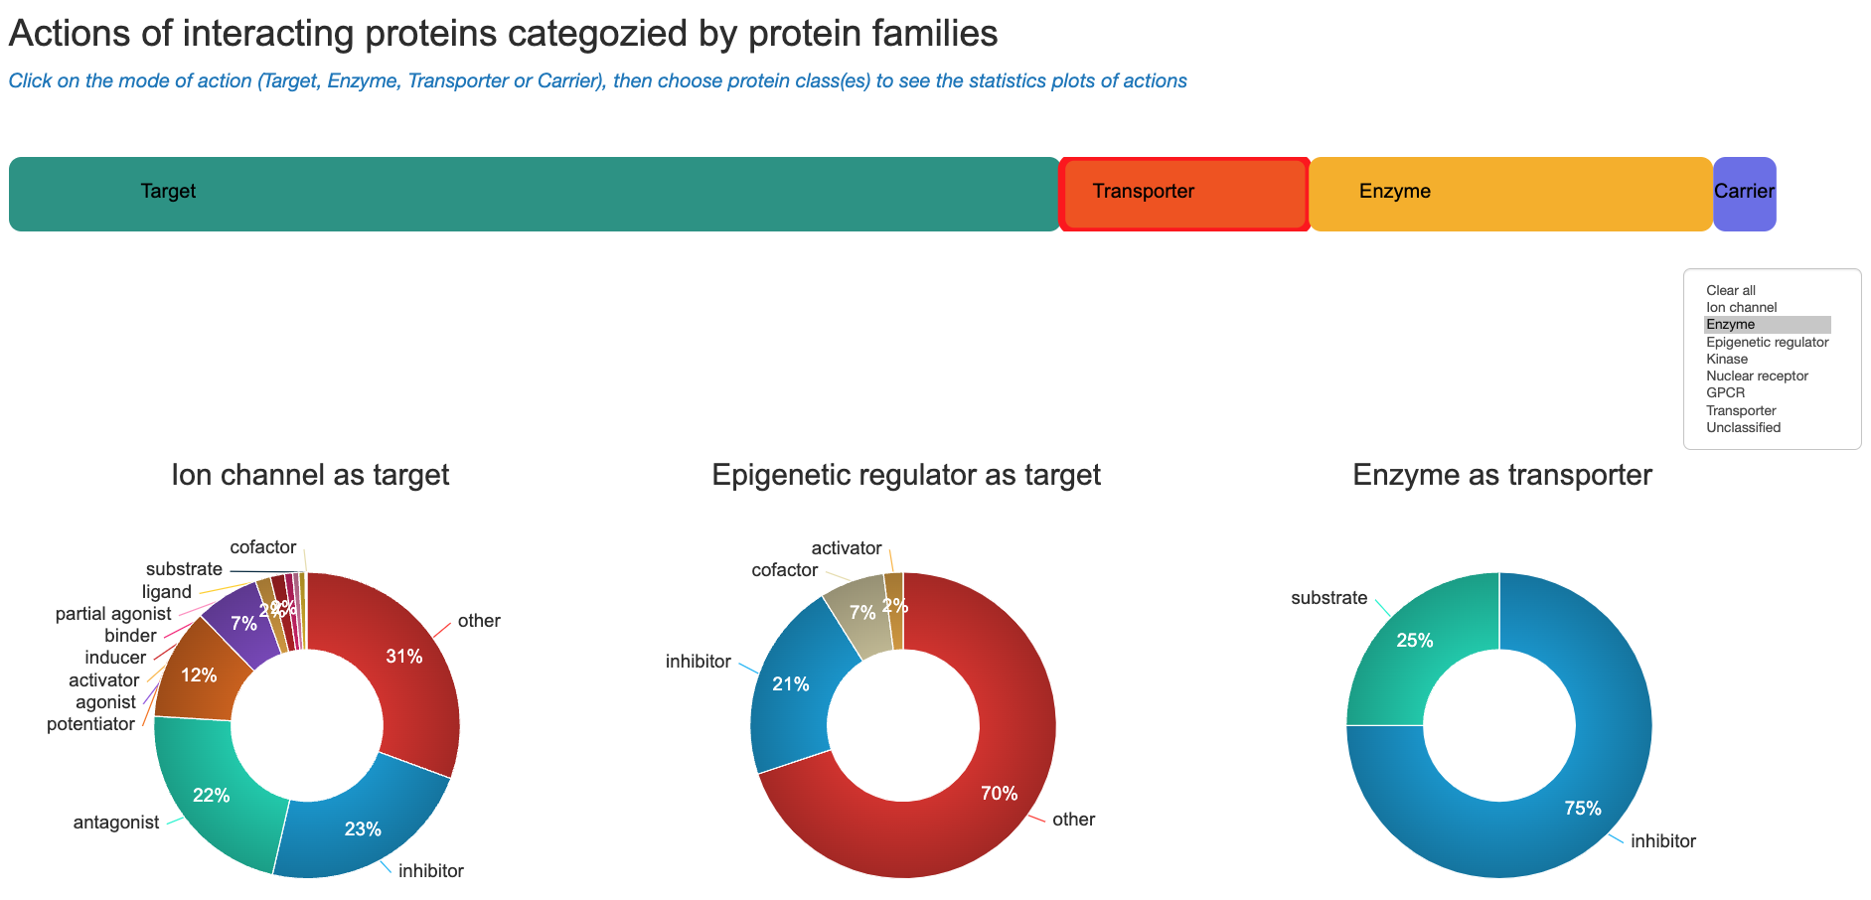
Choose a mode of action
Choose a class/category

Slide 11
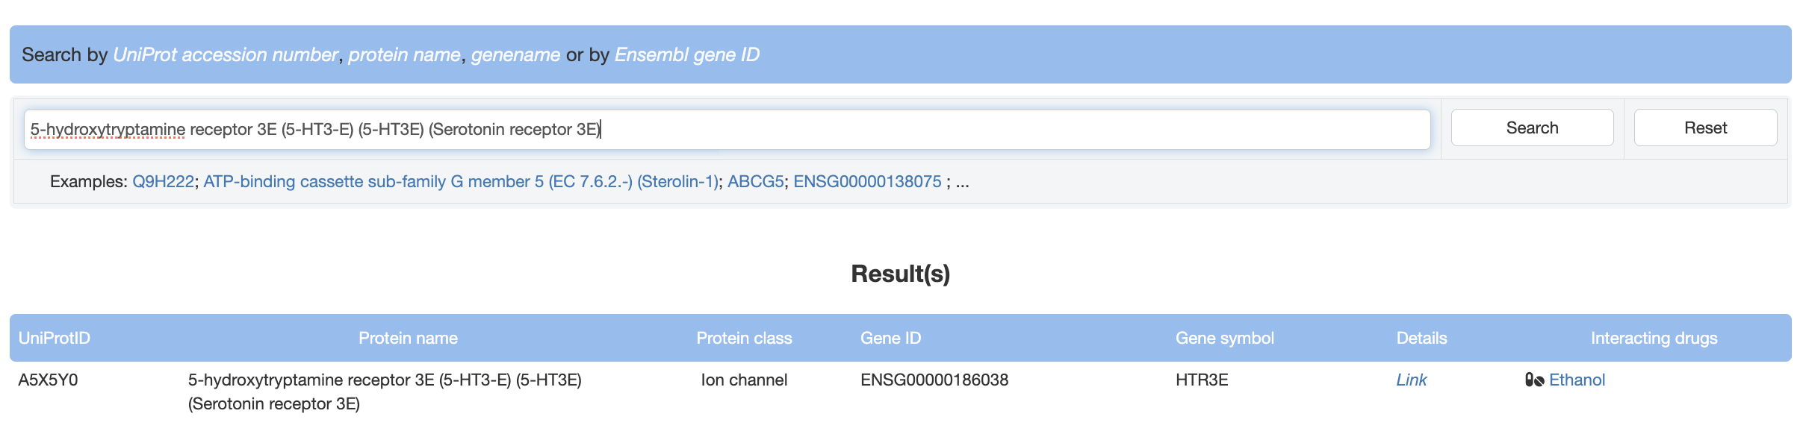
Use this search box to find a protein/gene. Autocomplete feature suggests possible matches as the user types.
Click here to open a detailed page for a protein/gene

Slide 12
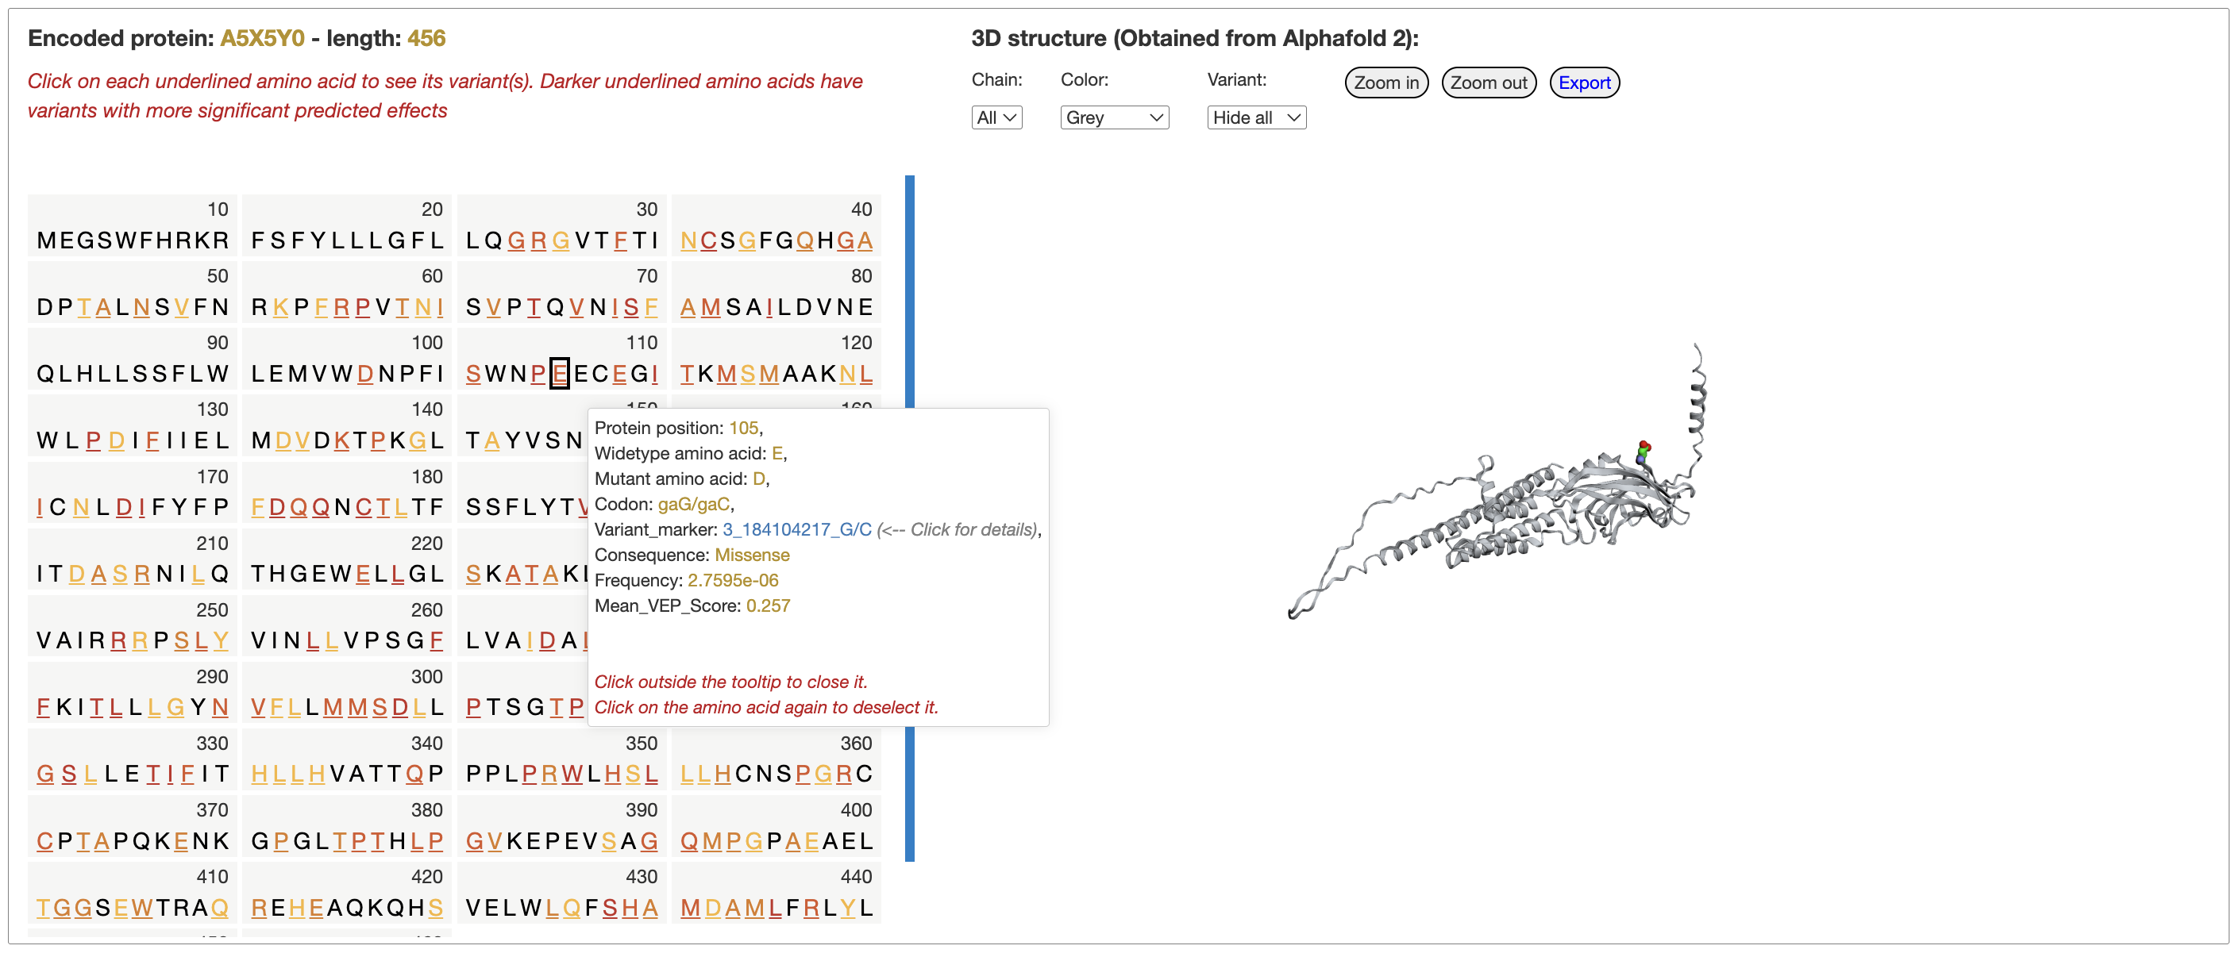

Slide 13
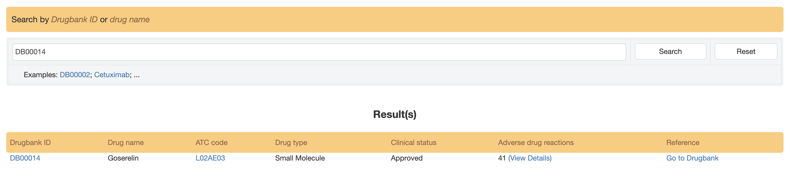
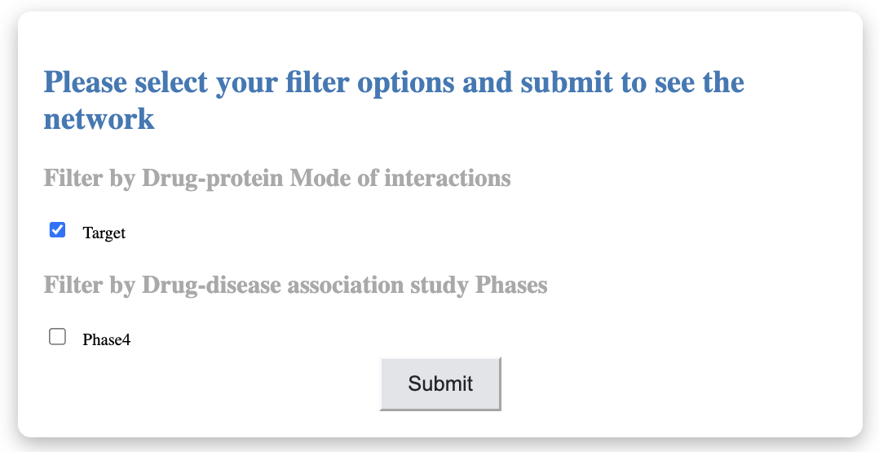
Click here to open a detailed page for drug-protein interactions in a network style
Use this search box to find a protein/gene. Autocomplete feature suggests possible matches as the user types.
Then choose “Target” andpress “Submit” in the pop-up diaglog

Slide 14
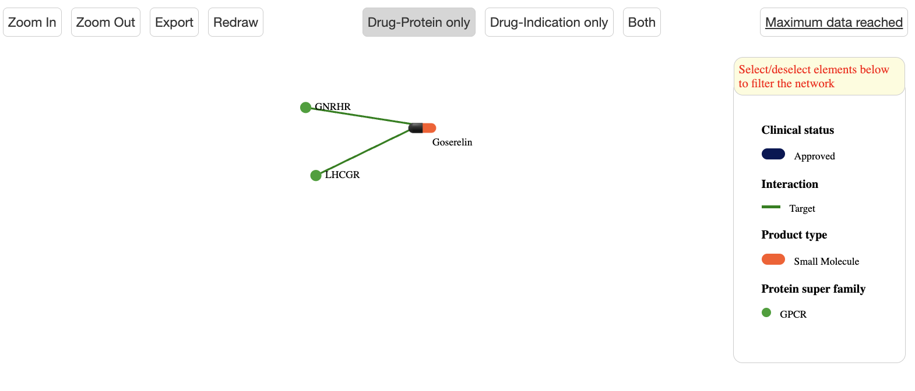
Right click on the circle icon to see protein detail information
Find the protein families here

Slide 15
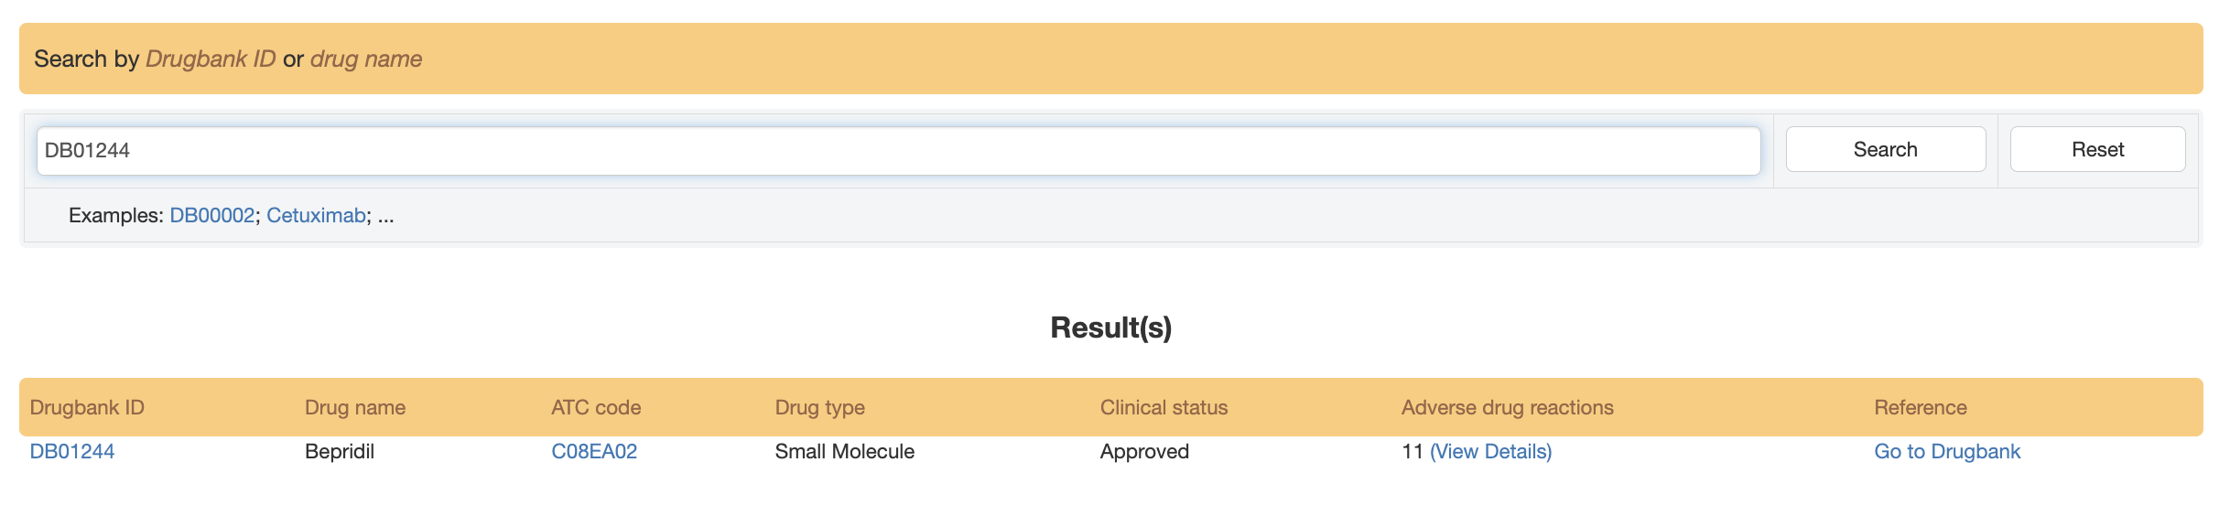
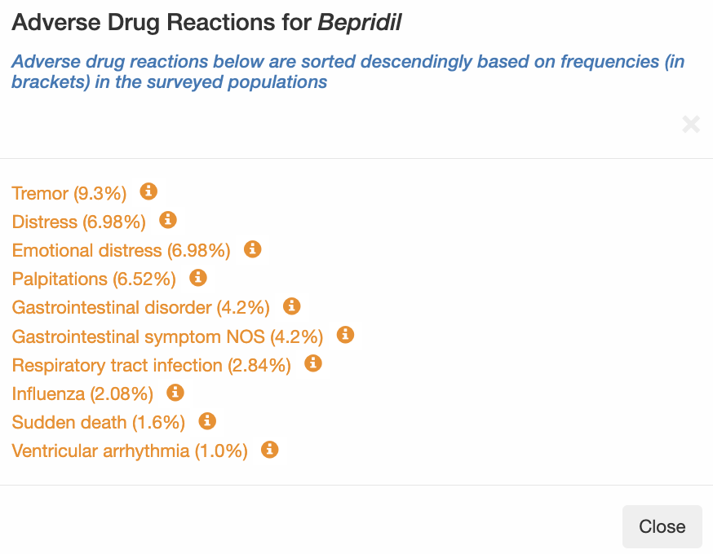
Click on ”View Detail” to show the pop-up diaglog
“Adverse Drug Reactions for Bepridil”

Slide 16
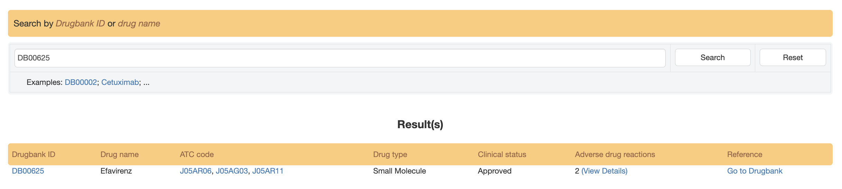
Click on the assigned ATC code for “Efavirenz” will open a new page with an abundance of information

Slide 17
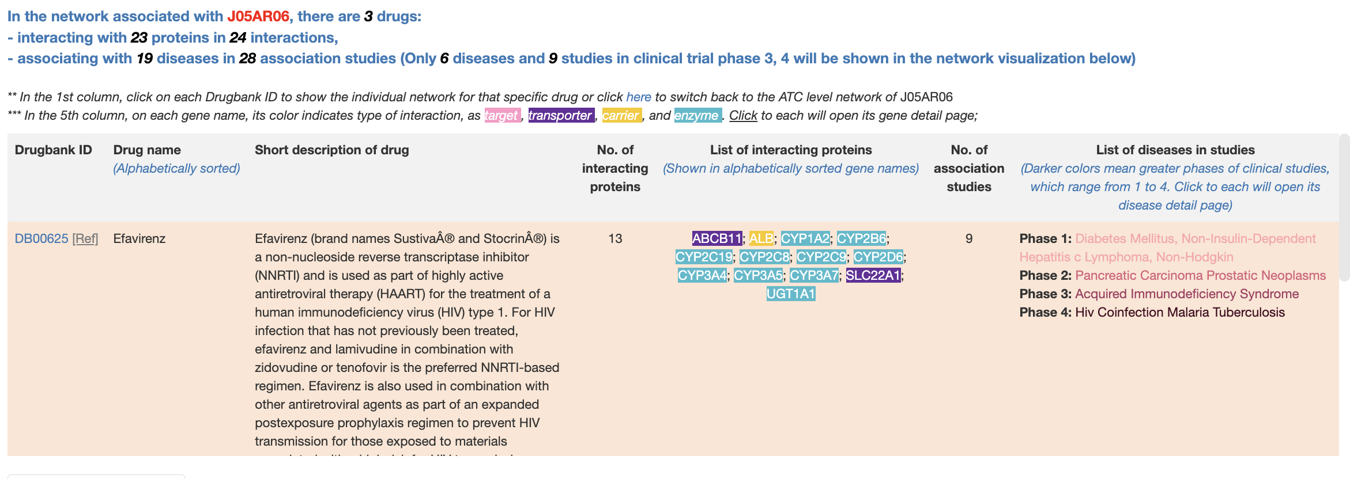
Diseases with association studies in different trial phases. Click on each disease will open a new page for further information
Information for “Efavirenz” will be show in this row
Sroll down for hidden information

Slide 18
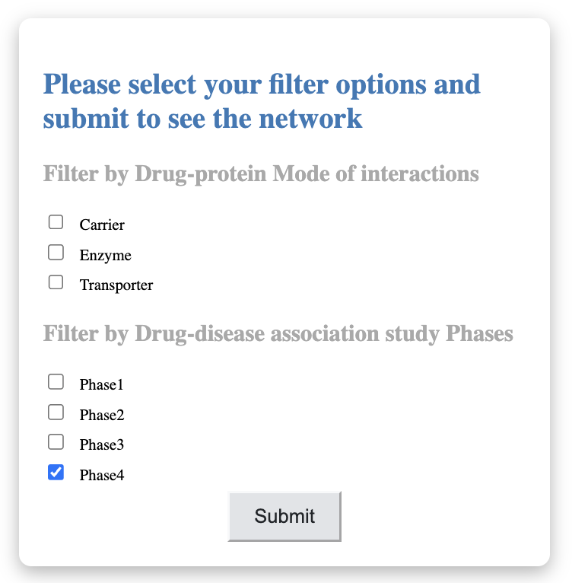
Click here to filter the indication-disease association studies of trial 4 to be shown in the network

Slide 19
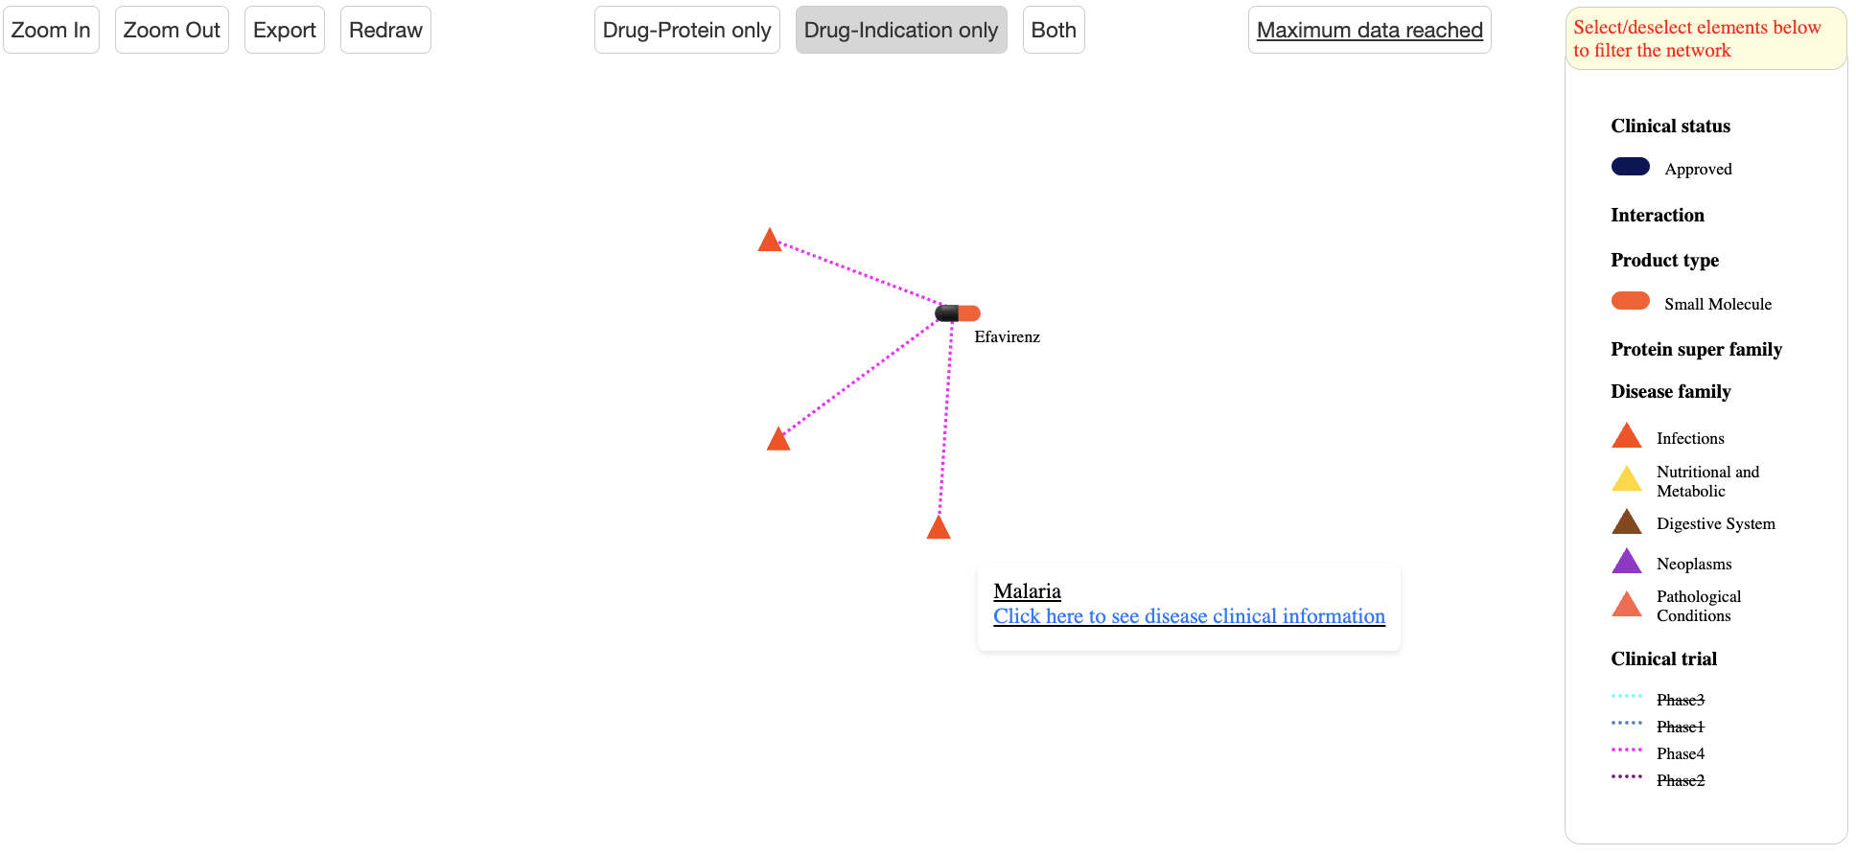
Choose Drug-Indication network
Hovering around triangle icons for disease names and link to detailed page
Disease classes are shown here

Slide 20
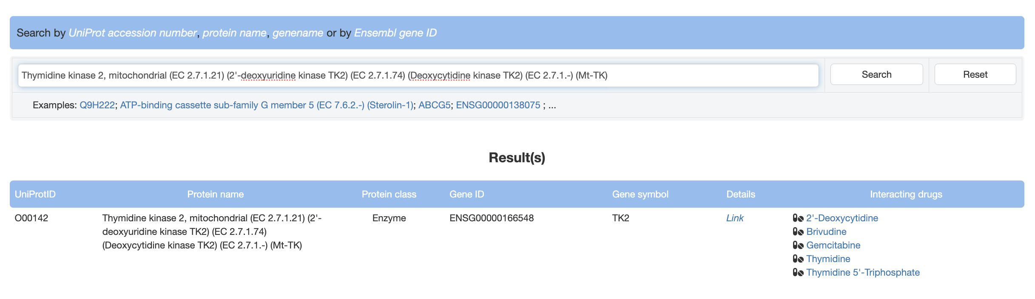
Click here to open a new page for gene details

Slide 21
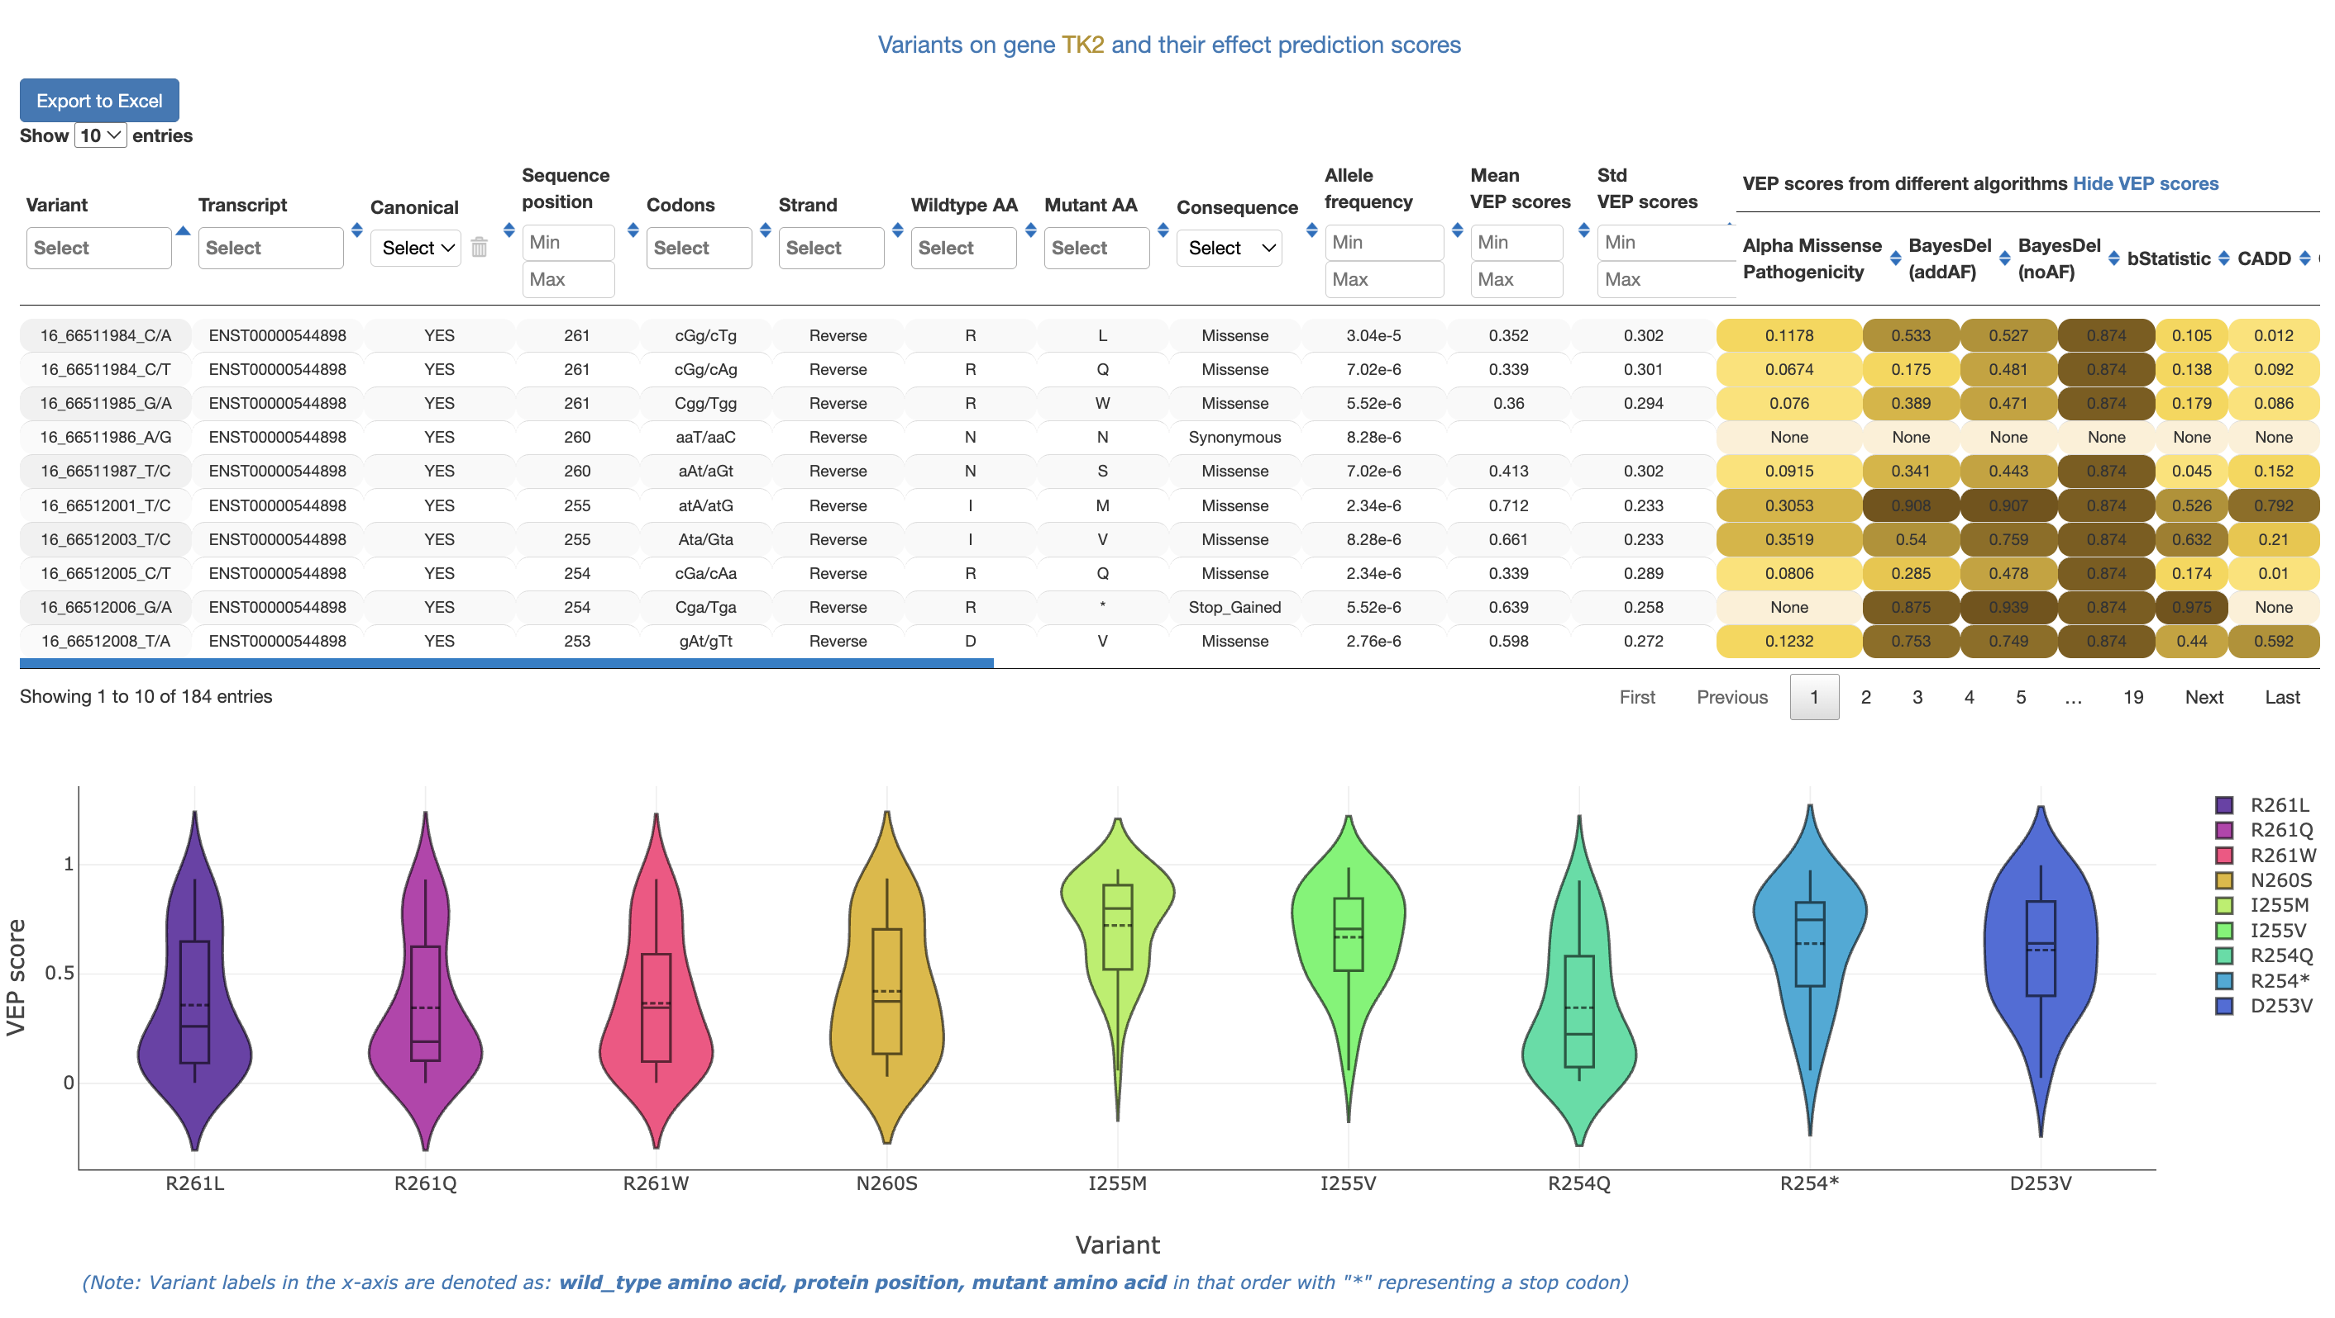
Specifify min value here (i.e., 0.7)

Slide 22
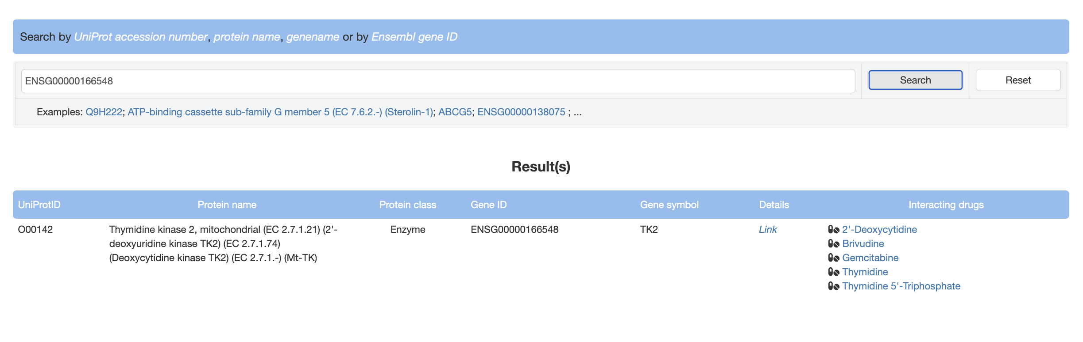
List of interating drugs for “Thymidine kinase 2” is shown here. Click on each drug to open its new specified page

